Slide 1



UNIT 7:
On top of the world
Animals –
high and low

Slide 2
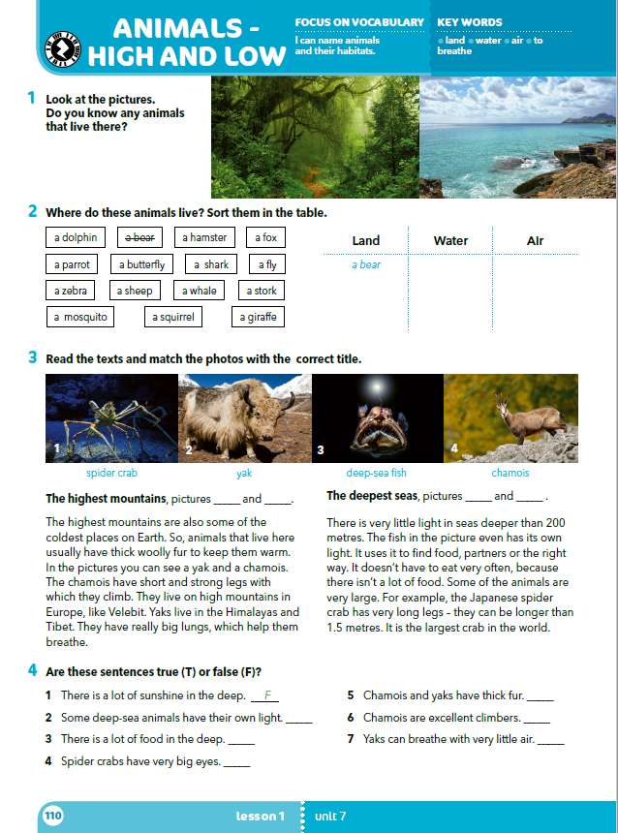
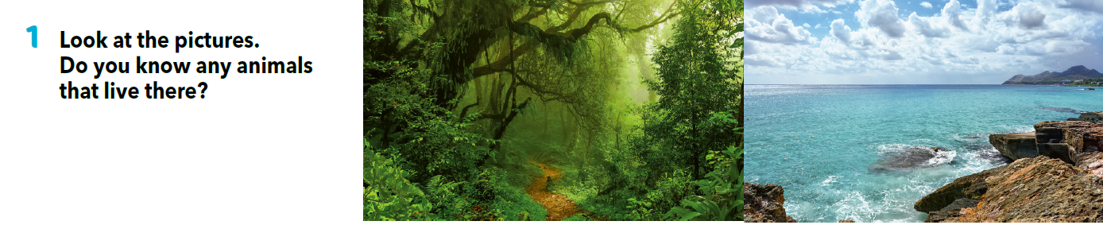
In pairs, write as many different animals as you can in 90 seconds.
Go back to your list of animals. Which animals that are on your list live in these habitats?

Slide 3
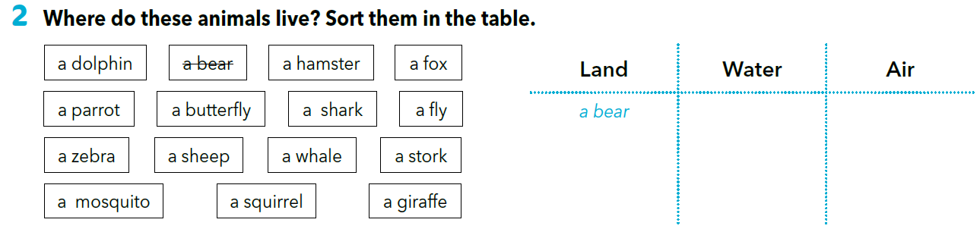
a dolphin,
a shark,
a whale
a parrot,
a butterfly,
a fly, a stork,
a mosquito
a hamster, a fox,
a zebra, a sheep,
a squirrel, a giraffe
Sort the animals in the table.
Optional: add 2-3 extra animals to each of the categories.

Slide 4
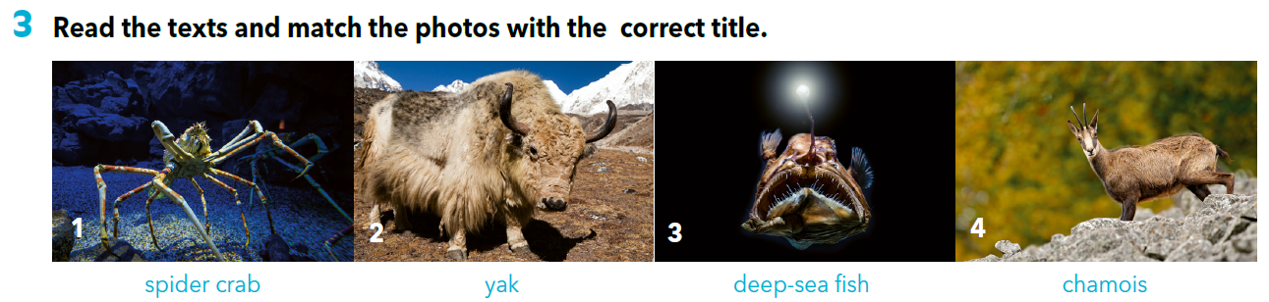
Look at the photos and describe the animals. These questions can help you.
Where are they?
Do you think it’s cold there?
Would you like to go there?
Have you seen anything like this animal?

Slide 5
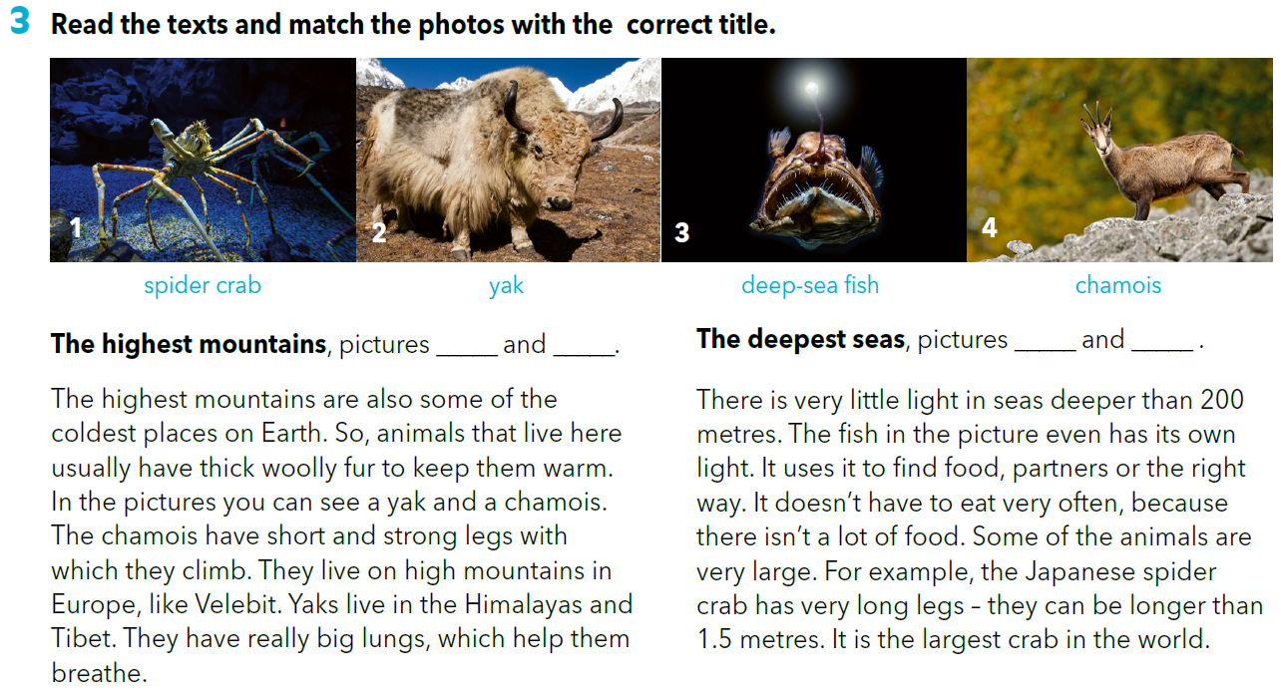
2 4
1 3

Slide 6
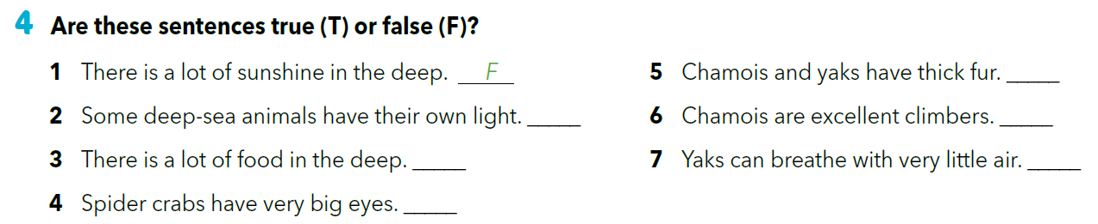
T
T
T
F
T
F

Slide 7
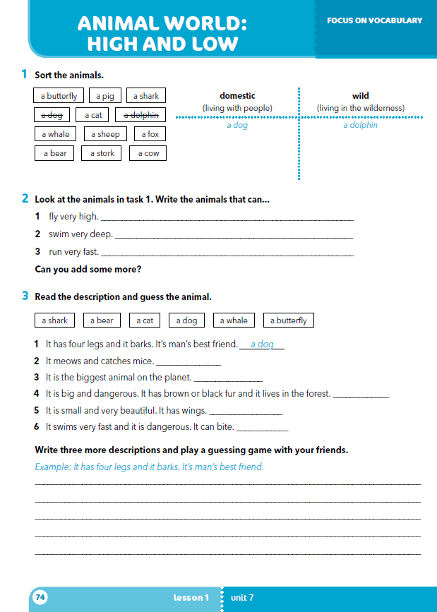
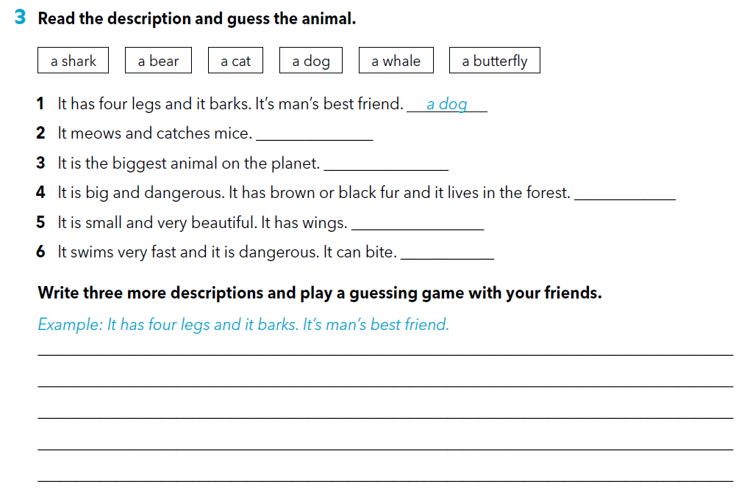
workbook p. 74
a cat
a whale
a bear
a butterfly
a shark

Slide 8
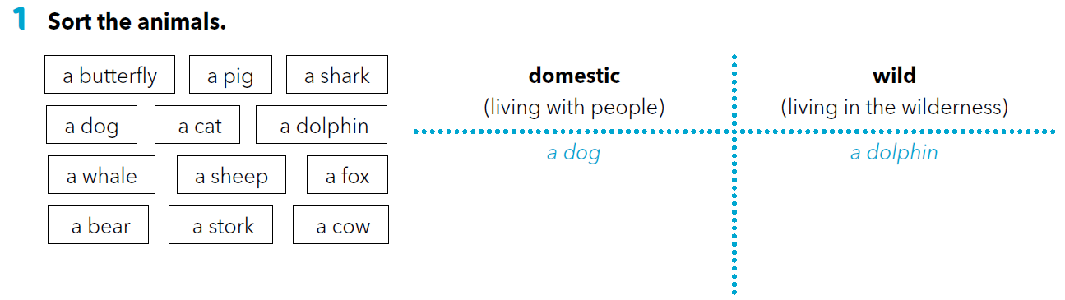
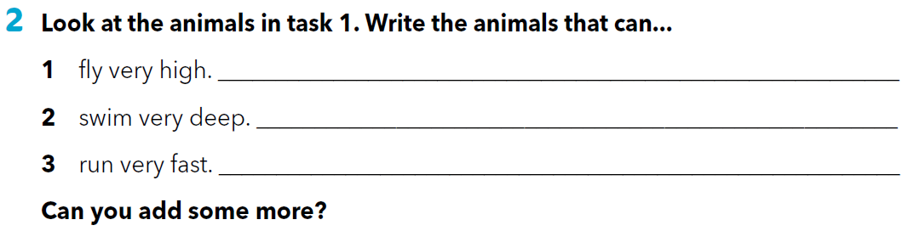
a pig, a cat,
a sheep, a cow
a butterfly, a shark,
a whale, a fox,
a bear, a stork
a stork, a butterfly
a whale, a shark
a dog, a cat, a fox

Slide 9
LET’S REVISE!
Use the flashcards and revise the names of animals.
https://quizlet.com/301496378/animal-world-flash-cards/

